Slide 1
Café B2D
Toronto, ON Location

Slide 2
Introduction
Café B2D (Bean 2 Drip) is an up-and-coming café specializing in high end coffee related beverages, exceptional pastries and made-to-order items. The client who is opening the new café comes with over 20 years in the industry and has become a leader in the field. They have selected Toronto as the starting point for their venture as it is their hometown and Toronto has the market to support this new take on a café.

Slide 3
Problem
Market saturation has been making it increasingly difficult to find a viable location
Need to find a location that meets the following criteria
Average yearly income needs to be greater than or equal to $150k
Neighbourhood not overly saturated with other venues
Population (including surrounding area) needs to be greater than 7,500
Out of scope
Real estate availability
Zoning restrictions
Overall attractiveness of the area (does it fit with the brand)

Slide 4
Data
Demographic data is retrieved from the Toronto open data platform
https://ckan0.cf.opendata.inter.prod-toronto.ca/download_resource/ef0239b1-832b-4d0b-a1f3-4153e53b189e?format=csv
Geographic data is retrieved from the Toronto open data platform
https://ckan0.cf.opendata.inter.prod-toronto.ca/download_resource/a083c865-6d60-4d1d-b6c6-b0c8a85f9c15?format=csv&projection=4326
Geojson data retrieved from GitHub
https://raw.githubusercontent.com/jasonicarter/toronto-geojson/master/toronto_crs84.geojson
Venue data retrieved from Foursquare using their api

Slide 5
Data Cleaning
The data retrieved from the Toronto open data platform had a lot of information that needed to be dropped
The demographic data has over 2000 columns that had to be transposed to rows and then majority of the data needed to be dropped
Renamed columns
Added additional calculated fields
Was able to narrow the list of neighbourhoods down to five based on the criteria

Slide 6
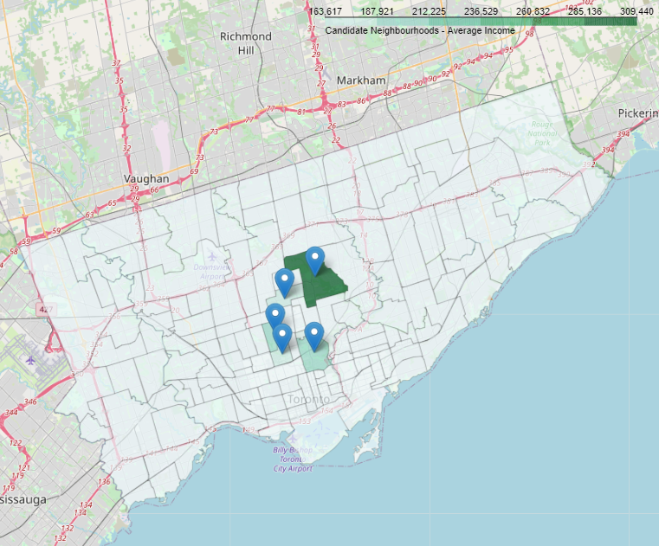
Visualizing the Neighbourhoods
Selected neighbourhoods are in close proximity to each other
All are located in central Toronto
Lawrence Park South
Bridle Path – Sunnybrook – York Mills
Rosedale – Moore Park
Forest Hill South
Casa Loma

Slide 7
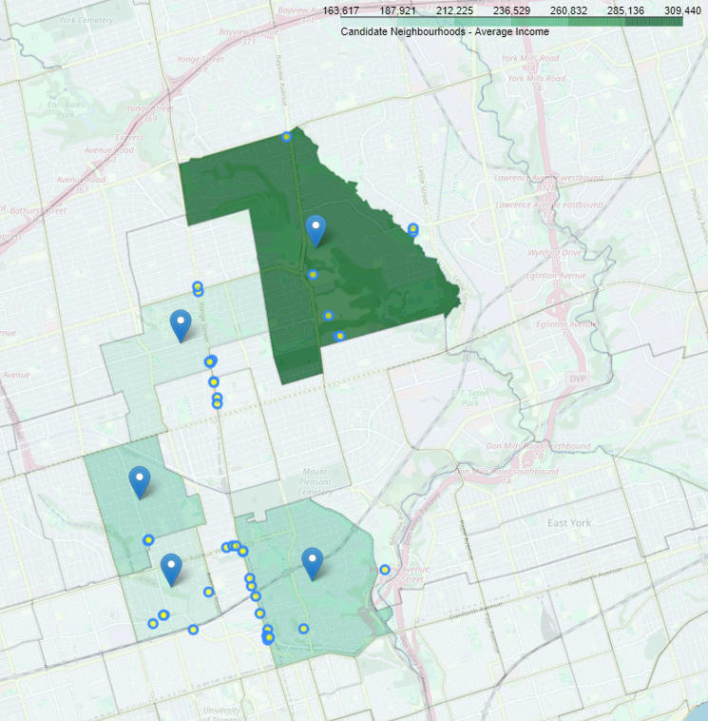
Visualizing the Venues
Blue dots with yellow centers depict venues
Venues seem to have more clusters in the southern region
Bridle Path – Sunnybrook – York Mills
Lawrence Park South
Forest Hill South
Rosedale – Moore Park
Casa Loma

Slide 8
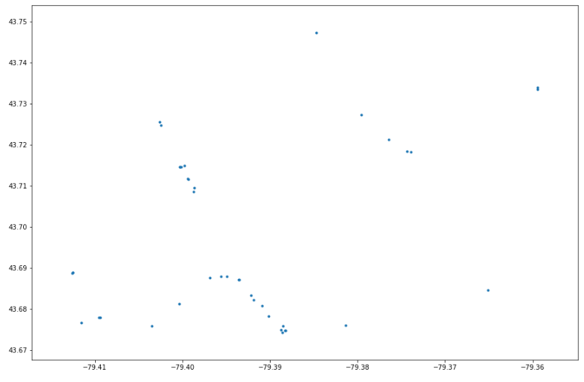
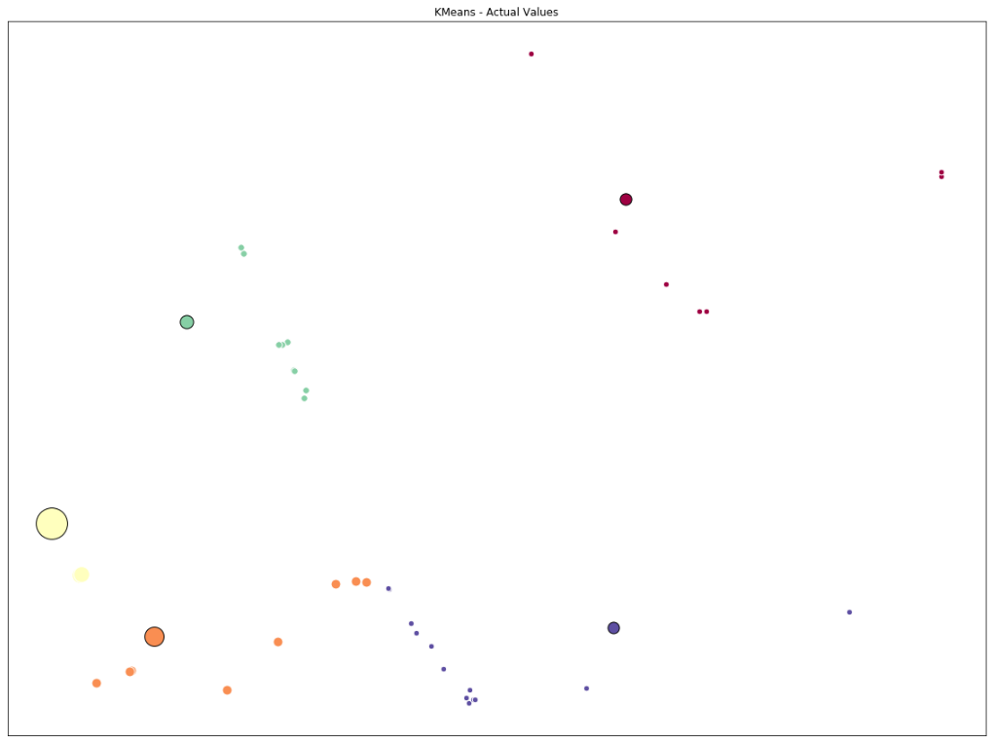
Compare Neighbourhoods to Venues

Slide 9
Recommendations and Conclusion
Top 3, in order, are:
Forest Hill South (population per venue is 3577)
Casa Loma (population per venue is 2194)
Lawrence Park (population per venue is 1518)
The population per venue for Forest Hill South shows that the area is not highly saturated with other venues as there are only three listed for it. This puts the population per venue at 3,577 which is almost 1,400 more than the next closest location.
Other characteristics will be used by the client in the final decision of location which may include real estate availability, zoning restrictions and overall attractiveness of the area (does it fit the brand).

